Slide 1


and You:
What can we learn about Meetup by looking at the data?

Slide 2
What is meetup all about?
Why do people use Meetup?
What are the most popular Meetup groups in Northeast Ohio and are these results consistent compared to other regions?
What areas have the most engagement?
What types of activities are most popular?
Is group membership related to age of the group? (i.e.- older groups would be larger)

Slide 3
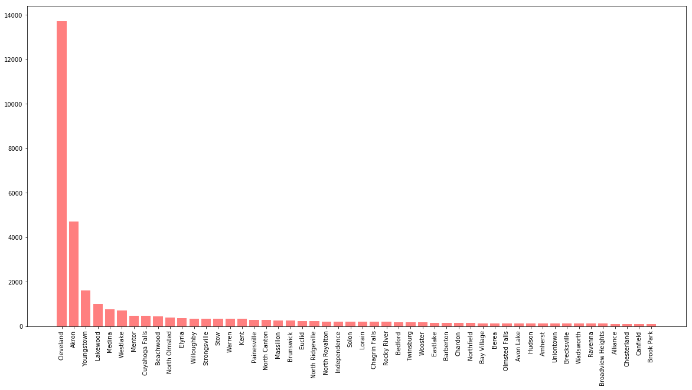
Northeast Ohio Meetup Participation follows City Centers

Slide 4
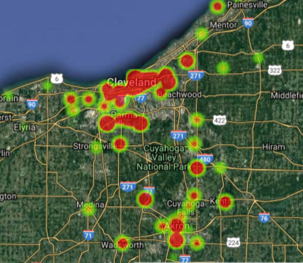
Which Northeast Ohio cities are the most active?
Cleveland had by far the greatest participation, with over 14,000 users. This was almost 3x the next highest amount
The heatmap shows high levels of activity in and around major population centers in Cleveland and Akron

Slide 5
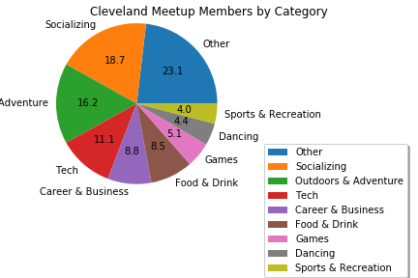
In Northeast Ohio, Socializing was the most popular unique category, followed by Adventure

Slide 6
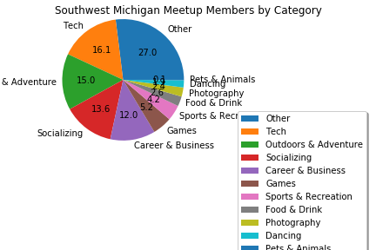
In Southwest Michigan, Tech was the most popular unique category, followed by Adventure; Socializing was the third most popular category

Slide 7
How did you guys find and clean the data?
Meetup’s robust documentation gave us initial ideas. After running our calls, we looked at the json to find data items that were available.
We used the console to determine which data sets were available and what the URL should be
We were fortunate to have good data from Meetup, with few problem cells. Where needed, we removed rows or columns that we did not need for the analysis

Slide 8
What does the data tell us about participation?
On average, in the Cleveland area, each meetup member subscribes to 6.6 groups.
Of the top 200 groups, the groups with the largest membership : Cleveland 20, 30 Club with 8,404 members
Smallest group in our data set was 19 members- Broken Trail Adventures,

Slide 9
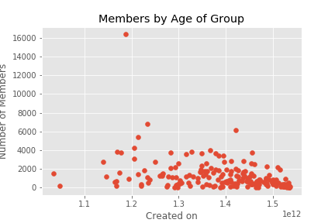
Older Doesn’t Mean Larger Groups
We ran a scatter plot comparing date founded and membership and found no relationship between group age and number of members.
The data shows that group size is independent of age of group

Slide 10
Conclusions: All Meetup is Local
While the data confirmed our hypothesis, the results were much more nuanced
Socializing was the leading category in Northeast Ohio vs. Tech in the Detroit/ Ann Arbor Region
Age of group was not a significant driver of group size
Overall, while we saw similarity between top uses of Meetup, top categories are driven by local differences

